Slide 1


Natural Language Processing (NLP)
Sentiment Analysis of Hotel Review

Slide 2
Agenda
Natural Language Processing
EDA
Sentiment Analysis (Using (hotel_reviews.xlsx))
Deployment using Streamlit

Slide 3
EDA
Duplicate Values
Describe the Data
Shape of Data
Unique Values

Slide 4
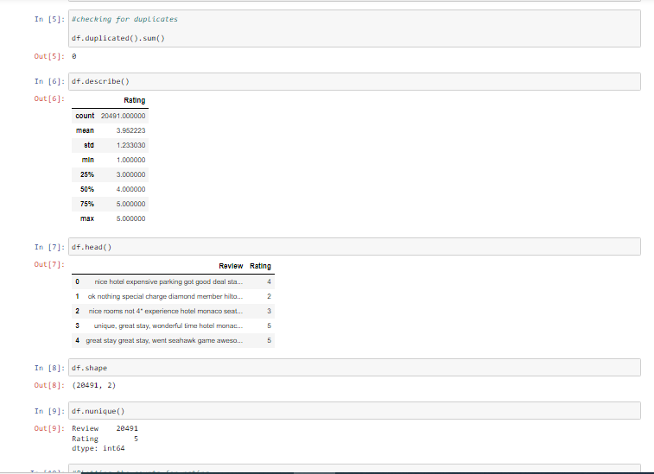
Understanding the Data

Slide 5
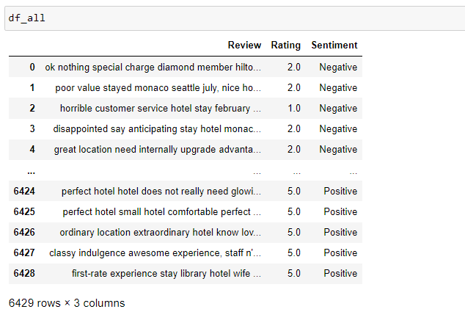
Coustumer Sentiment

Slide 6
Natural Language Processing
Natural language processing (NLP) refers to the branch of computer science—and more specifically, the branch of artificial intelligence or AI—concerned with giving computers the ability to understand text and spoken words in much the same way human beings can. It allows machines to break down and interpret human language.

Slide 7
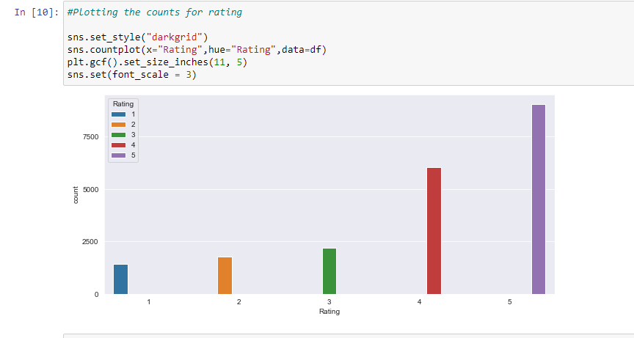
Visualization in EDA
Count plot shows from seaborn library for observing the maximum rating

Slide 8
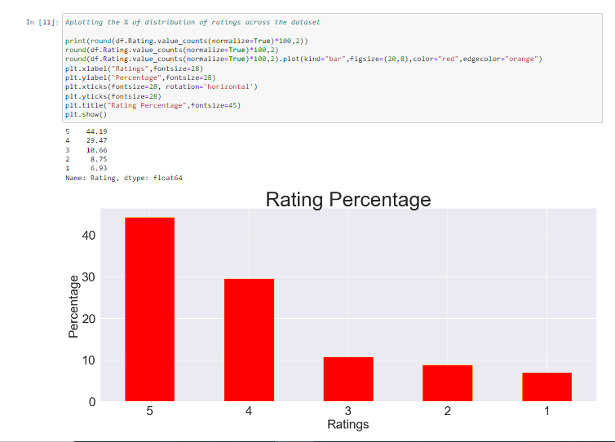
Percentage of Rating of the Dataset

Slide 9
Normalizing the data
To remove both the leading and the trailing characters
To remove empty strings
Joining the list into one string/text
Removing Punctuations
Tokenization / Removing stopwords / Lemmatization / Stemming
Joining the data

Slide 10
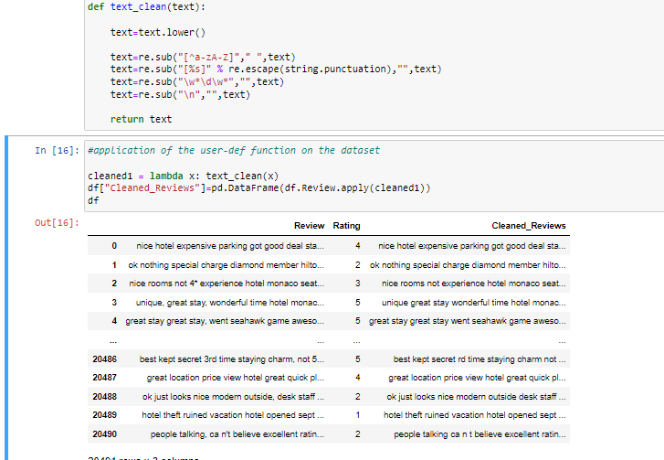
Removing Punctution,Special Characters and Numerical values

Slide 11
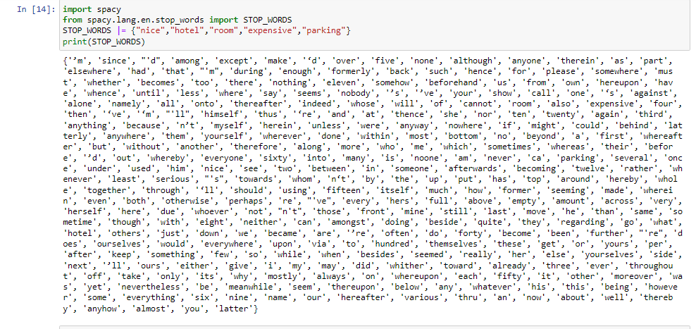
Stop Word

Slide 12
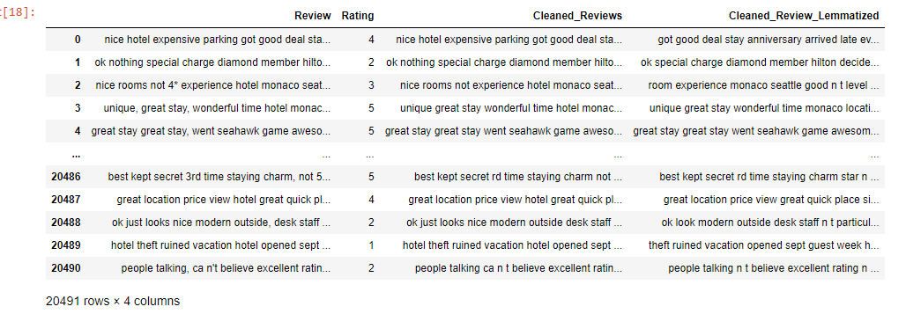
Lemmatization

Slide 13
Vectorization & Feature Extraction
TF-IDF Vectorizer
Generate Word Cloud
Polarity Score and Subjectivity

Slide 14
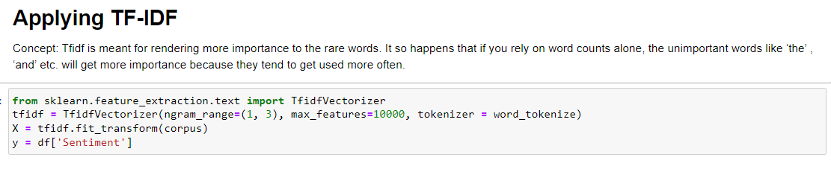
TF-IDF

Slide 15
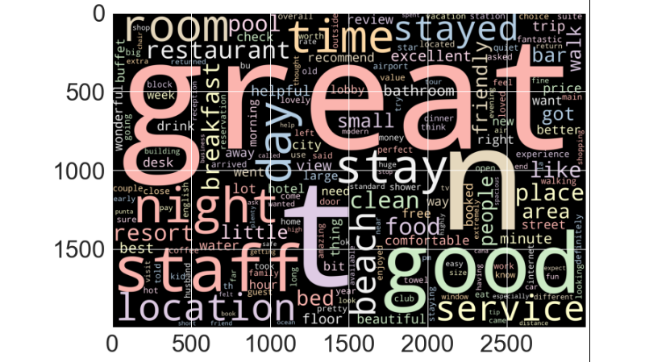
Positive Words In Data

Slide 16
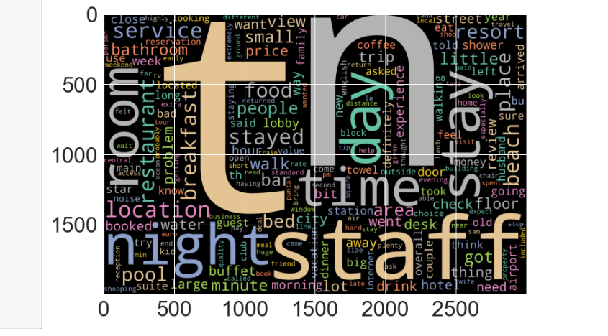
Negative words in Data

Slide 17
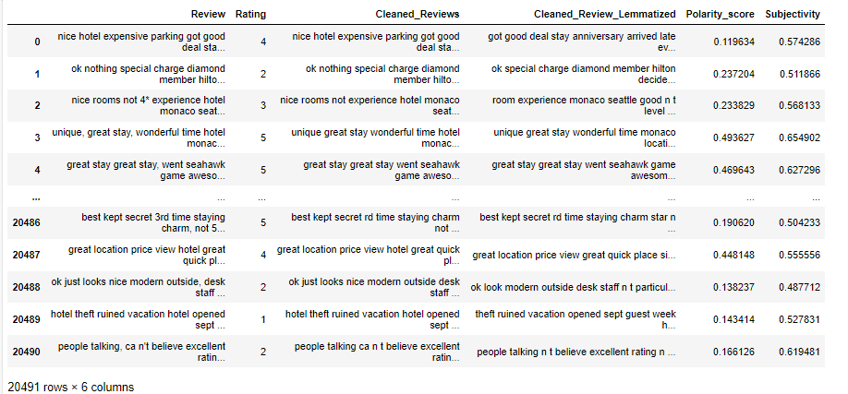
Polarity Score and Subjectivity

Slide 18
we done with EDA part and Feature extraction, Now we are in third step called MODEL BUILDING.

Slide 19
Models used for Model Building
1) Gaussian Naive Bayes
2) Multinomial Naive Bayes
3) Decision Tree Classifier
4) Random Forest
5) AdaBoost Classifier
6) XGBoost
7) LGBoost

Slide 20
Model Name Accuracy
1) Gaussian Naive Bayes 76.83
2) Multinomial Naive Bayes 92.36
3) Decision Tree Classifier 85.82
4) Random Forest 89.33
5) AdaBoost Classifier 90.92
6) XGBoost 92.41
7) LGBoost 92.43
By looking at the accuracy of the models, LGBoost seems to be the best model for the classification of Hotel Reviews

Slide 21
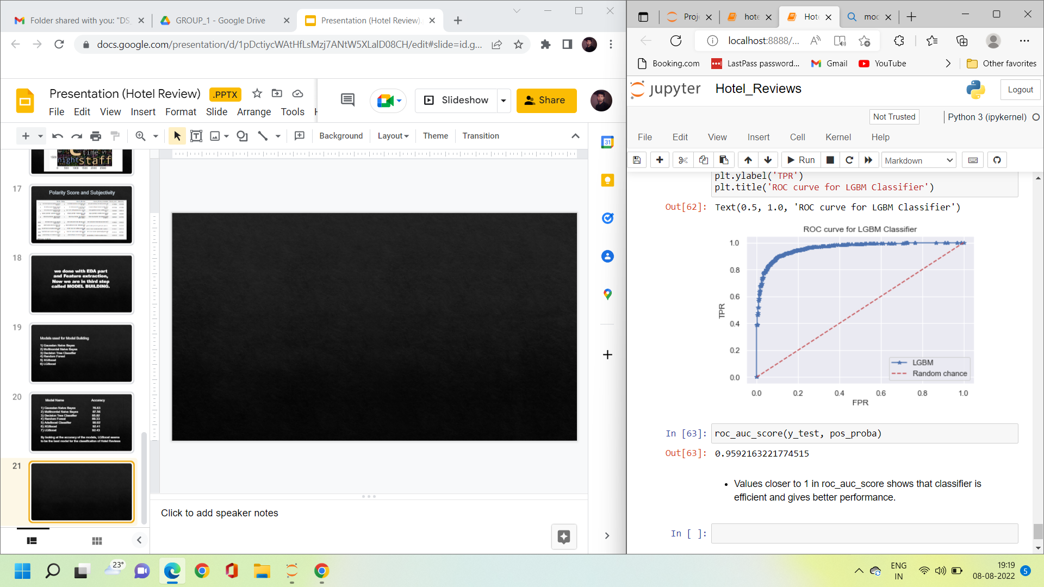
The Receiver operating Characteristic(ROC) curve is a plot of the pairs of TPR on X-axis and FPR on X-axis
Values closer to 1 in ROC curve shows that model is efficient and gives better performance

